Slide 1

USC MSBA Sustainability Case Competition
By:
Himani Desai
Mridula Singhal
Pratik Khadse
Rizabek Zhumkenov
Team ECO-LUTION: Sustainability Case Competition April 6, 2022

Slide 2
2050
2025

Slide 3
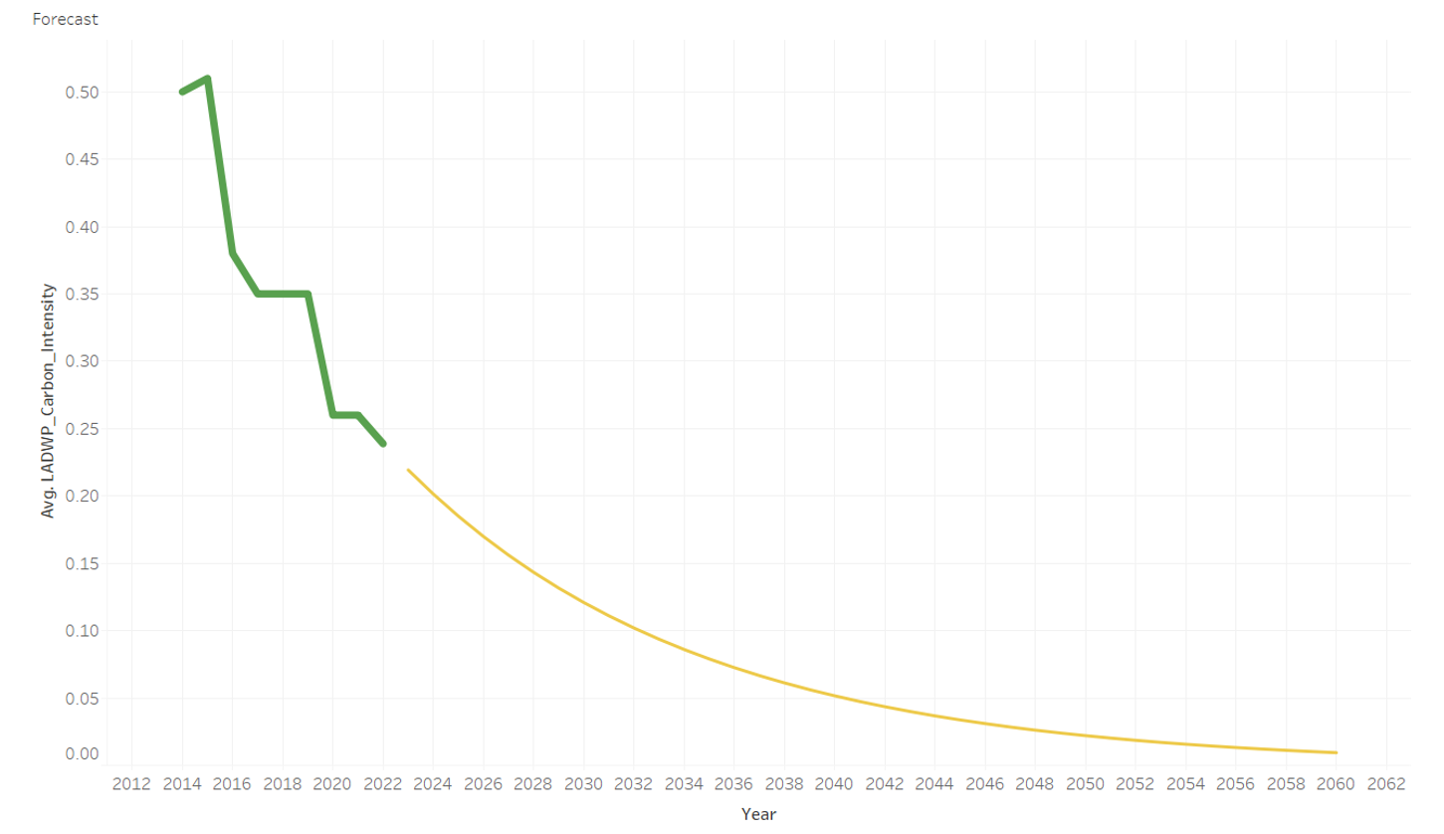
Carbon Neutrality
Time to Reach Carbon Neutrality
Average Decrease in Carbon Intensity per year: 8.1%

Slide 4








STARS Peer Comparisons
87.1
85.0
PLATINUM
67.7
67.3
65.0
GOLD
57.8
45.0
SILVER

Slide 5
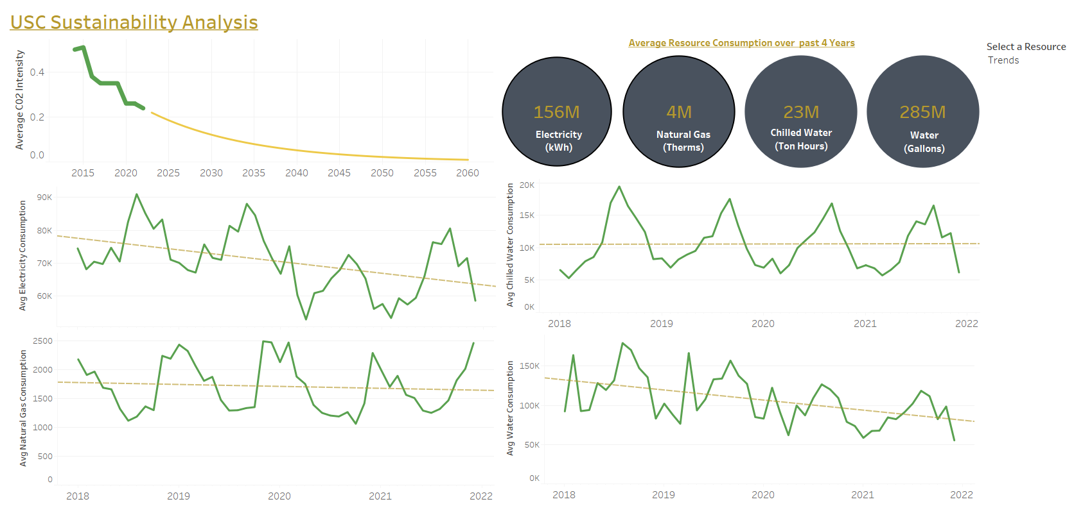
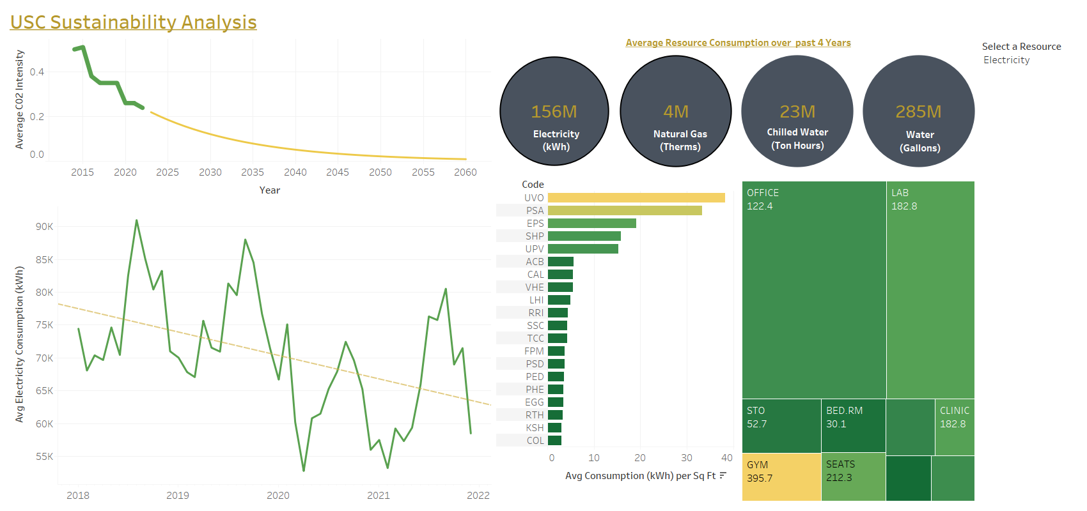
Finding Actionable Data
Association: Chilled Water and Electricity
Decreasing Trend

Slide 6
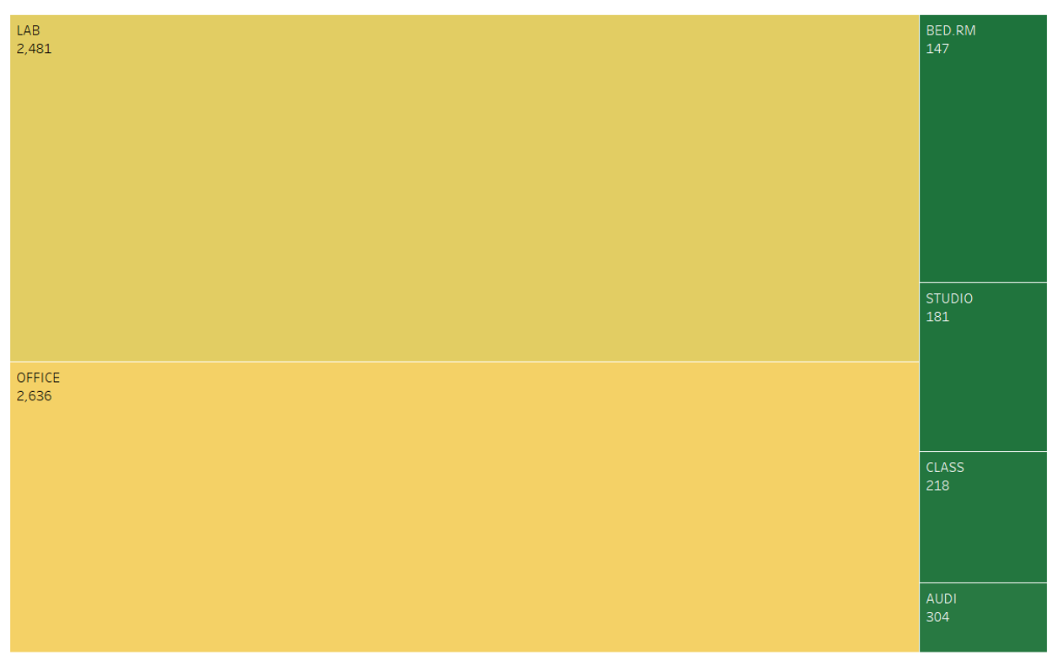
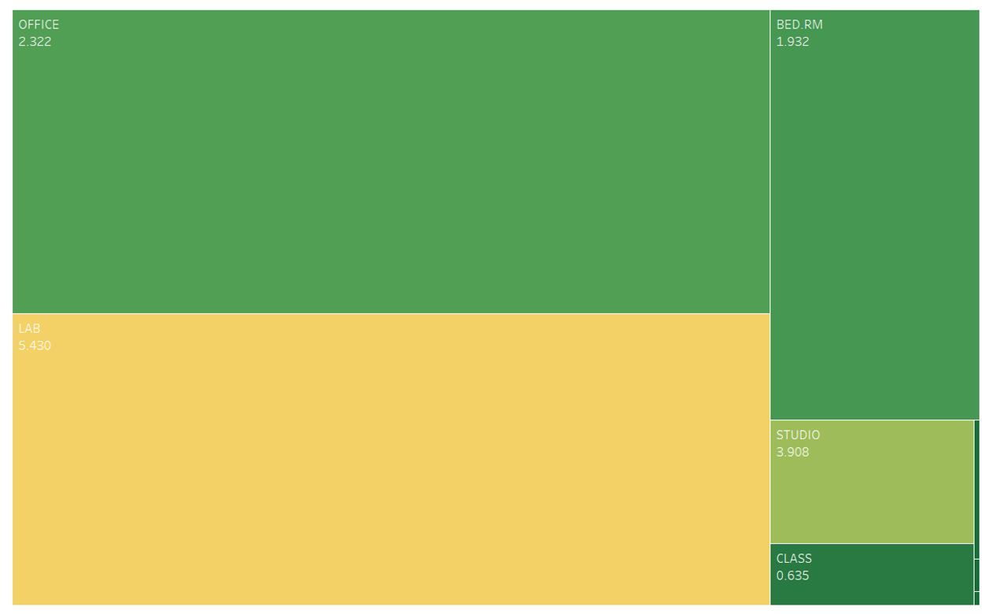
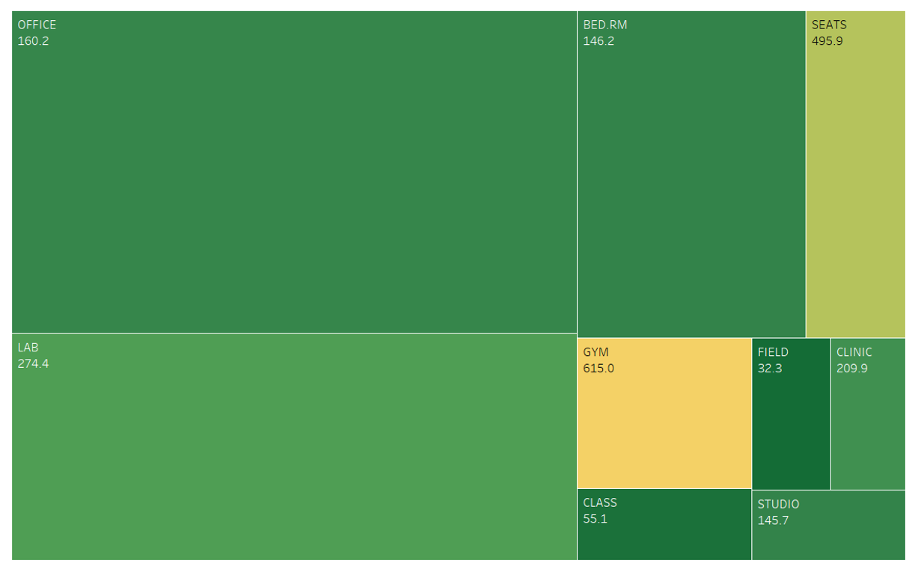
Major Usage by Building Type
Major usage: Labs | Office | Gyms
11%
5%
15%

Slide 7
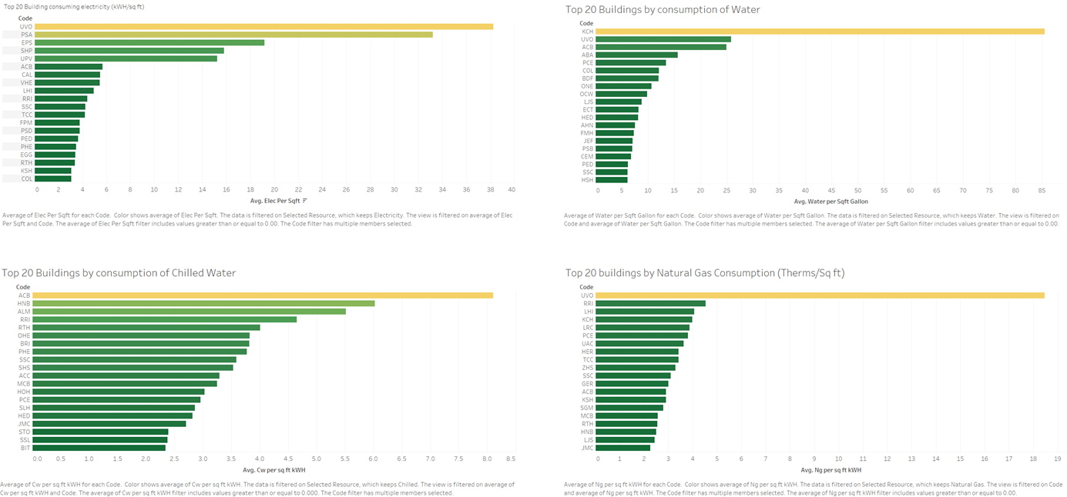
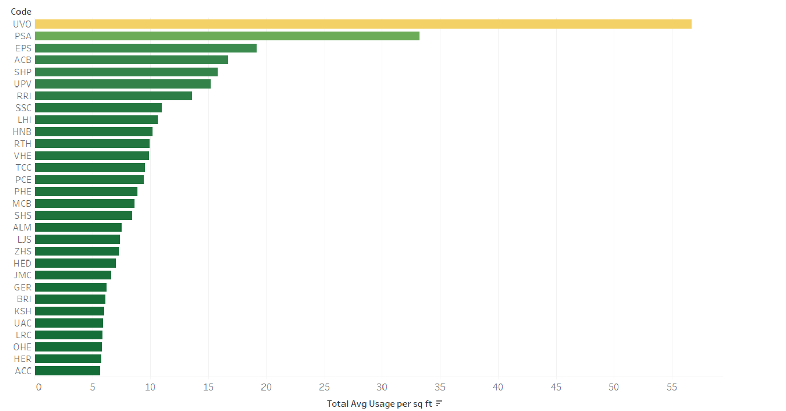
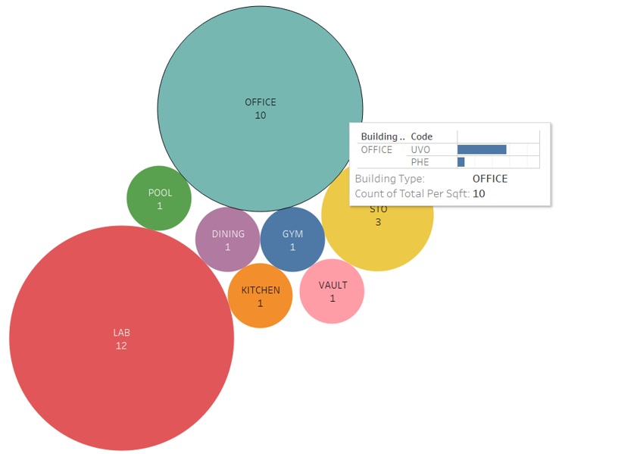
Focus on the Outliers
Top 3 electricity users: 28%
Top 1 Natural Gas users: 10%
Top 3 Chilled Water users: 14%
Top 1 Water users: 15%
UVO: 9% of Total Usage of Electricity, Gas and Chilled Water (kWh) and top 5: 22%

Slide 8





Recommendations

Slide 9
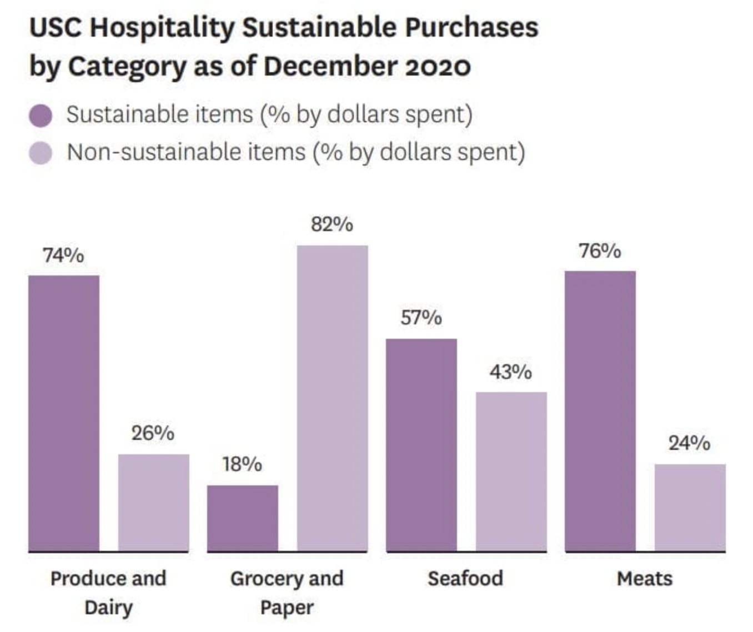
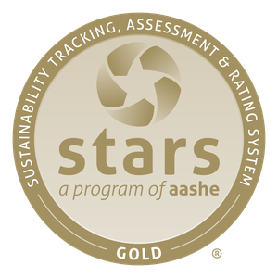
ROAD to GOLD
Current Score: 57.87
Sustainability Literacy Assessment: 0.00/4.00
+4.00
+1.00
+0.50
+0.50
+0.50
+1.50
Clean and Renewable Energy: 0.00/4.00
Water Use: 1.76/6.00
Food and Beverage Purchasing: 3.24/6.00
Building Design and Construction: 0.53/3.00
Waste Minimization and Diversion: 0.88/8.00
65.87

Slide 10
Conclusion
Funds Saved per Annum
Funds Generated per Annum
Energy consumption reduction by 20% in top 30 buildings→ $1,770,000
Green Fee: $9.50 per student and faculty per semester → $1,029,800
Gas consumption reduction by 20% in top 30 buildings → $500,000
Thrift Store: 1200 items with average $10 per item per month → $108,000 (after reducing thrift store costs)
Chilled Water consumption reduction by 20% in top 30 buildings → $2,130,000
$4,400,000
$1,137,800

Slide 11
FIGHT ON! ✌
Team ECO-LUTION: Sustainability Case Competition April 6, 2022

